Slide 1
Diffie-Hellman key exchange & ElGamal public key cryptosystem
Paulo Martins
Pedro Trindade
Patrick Cunha

Slide 2
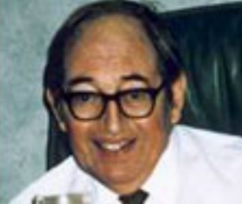


The birth of public key cryptography
The concept of public key encryption was originally discovered by James Ellis while working at the GCHQ in 1969.
Malcolm Williamson and Clifford Cocks discovered the Diffie-Hellman key exchange algorithm while working at the GCHQ in 1974, before its rediscovery and public dissemination.
James Ellis
Malcolm Williamson
Clifford Cocks
Diffie-Hellman key exchange

Slide 3
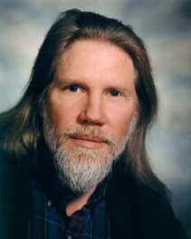

The birth of public key cryptography
Whitfield Diffie and Martin Hellman published their now famous paper “New Directions in Cryptography” in 1976, making several groundbreaking contributions to this new field.
Indeed their paper begins with a call to arms: “We stand today on the brink of a revolution in cryptography.”
Whitfield Diffie
Martin Hellman
Diffie-Hellman key exchange

Slide 4
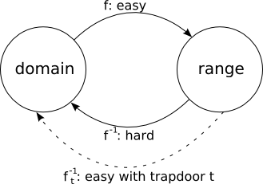
The birth of public key cryptography
The first important contribution of Diffie and Hellman in their paper was the definition of a Public Key Cryptosystem (PKC) and its associated components:
One-way functions
Trapdoor Information
Diffie-Hellman key exchange

Slide 5
One-way functions
A one-way function is an invertible function that is easy to compute, but whose inverse is difficult to compute.
It is difficult to compute the inverse if any algorithm used to do so in a reasonable amount of time (e.g., less than the age of the universe) will almost certainly fail.
Diffie-Hellman key exchange
Notes:
The strength of a one-way function is based on the time needed to reverse it: easy to reverse with small prime numbers, hard with big prime numbers.

Slide 6
Trapdoor information
The trapdoor is a piece of auxiliary information that allows the inverse of a one-way function to be easily computed.
There is a vast chasm separating the idea of a one-way trapdoor function and the actual construction of such a function.
Diffie-Hellman key exchange

Slide 7
Public Key Cryptosystem
The key consists of two pieces: a private key (kpriv) and a public key (kpub), computed by applying a key-creation algorithm to kpriv.
For each public/private key:
An encryption algorithm (ekpub), public knowledge and easy to compute.
A corresponding decryption algorithm (dkpriv), easily computable by someone who knows kpriv, difficult for someone who knows only kpub.
Diffie-Hellman key exchange

Slide 8
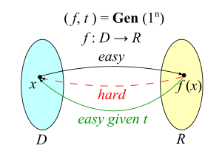
Public Key Cryptosystem
The function used to create kpub from kpriv must be difficult to invert.
The private key kpriv can be considered the trapdoor information to this one-way function, because without kpriv, it is very hard to compute the inverse function ekpub.
Diffie-Hellman key exchange

Slide 9
Public Key Cryptosystem
Despite years of research it is still not know whether one-way functions really exist.
Diffie and Hellman made several suggestions in their paper for one-way functions, but did not produce an example of a PKC, mainly for the lack of finding the right trapdoor information.
They did, however, describe a public key method (Diffie-Hellman key exchange), based on the assumption that the discrete logarithm problem is difficult to solve.
Diffie-Hellman key exchange

Slide 10
Discrete Logarithm Problem
Used for the construction of the public key, based in a finite field Fp with a prime number of elements.
Definition. Let g be a primitive root for Fp and let h be a nonzero element of Fp. The Discrete Logarithm Problem (DLP) is the problem of finding an exponent x such that.
g^{x} ≡ h (mod p).
Diffie-Hellman key exchange

Slide 11
Diffie-Hellman key exchange
The Diffie-Hellman key exchange is a method of securely exchanging cryptographic keys over an insecure communication channel.
It relies on the difficulty of the discrete logarithm problem.
It is a non-authenticated key-agreement protocol but provides the basis for a variety of authentication protocols such as the Station-to-Station (STS) protocol.
Diffie-Hellman key exchange

Slide 12



How does it work?
Insecure channel
Alice
Bob
Eve
Diffie-Hellman key exchange
Notes:
Eve is a passive attacker.

Slide 13
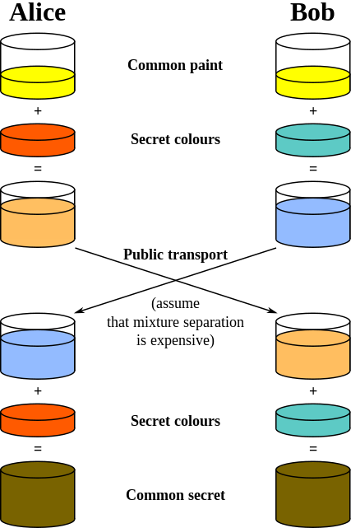
How does it work?
Diffie-Hellman key exchange
Notes:
If another party (usually named Eve in cryptology publications, Eve being a third-party who is considered to be an eavesdropper) had been listening in on the exchange,
it would be computationally difficult for that person to determine the common secret color; in fact, when using large numbers rather than colors,
this action is impossible for modern supercomputers to do in a reasonable amount of time.

Slide 14



Alice
Alice and Bob agree on a prime number p and a generator g such that: g is a primitive root of p p > g
Alice generates a random number (private key) a and computes: A ≡ gª (mod p)
Alice sends A to Bob
Alice computes the shared key Bª (mod p)
Eve
Eve sees p and g
Eve sees A and B
Bob
Alice and Bob agree on a prime number p and a generator g such that: g is a primitive root of p p > g
Bob generates a random number (private key) b and computes: B ≡ g^{b} (mod p)
Bob sends B to Alice
Bob computes the shared key A^{b} (mod p)
Step 1
Step 2
Step 3
Step 4
Bª (mod p) = (g^{b})ª (mod p) = (gª)^{b} (mod p) = A^{b} (mod p)
Diffie-Hellman key exchange

Slide 15
Alice
p = 941 g = 627
a = 347 390 ≡ 627³⁴⁷ (mod 941)
Alice sends 390 to Bob
Alice computes the shared key 691³⁴⁷ (mod 941), which is 470.
Eve
Eve sees 941 and 627
Eve sees 390 and 691
Bob
p = 941 g = 627
b = 781 691 ≡ 627⁷⁸¹ (mod 941)
Bob sends 691 to Alice
Bob computes the shared key 390⁷⁸¹ (mod 941), which is 470.
Step 1
Step 2
Step 3
Step 4
691³⁴⁷ (mod 941) = (627⁷⁸¹)³⁴⁷ (mod 941) = (627³⁴⁷)⁷⁸¹ (mod 941) = 390⁷⁸¹ (mod 941)
Diffie-Hellman key exchange
Notes:
The protocol uses the multiplicative group of integers modulo p, where p is prime, and g is a primitive root modulo p.
These two values are chosen in this way to ensure that the resulting shared secret can take on any value from 1 to p–1.
Once Alice and Bob compute the shared secret they can use it as an encryption key, known only to them, for sending messages across the same open communications channel.

Slide 16
Eve’s dilemma
In this example, Eve can reconstitute Alice’s and Bob’s shared secret if she can solve either:
627ª ≡ 390 (mod 941) or 627^{b} ≡ 691 (mod 941).
If Eve can solve the DLP, then she can compute the secret exponents a and/or b from the intercepted values of A and B, making it easy for her to compute the shared key.
Diffie-Hellman key exchange

Slide 17
Diffie-Hellman Problem
There is another problem called Diffie-Hellman Problem (DHP), no harder than the DLP that Eve could solve to find the shared key:
Definition. Let p be a prime number and g an integer. The DHP is the problem of computing the value of g^{ab} (mod p) from the known values of gª (mod p) and g^{b} (mod p).
Diffie-Hellman key exchange
Notes:
Solving the DLP is one method of finding the shared key, but that’s not the precise problem that Eve needs to solve.

Slide 18
Security
Secure if values are chosen properly and with adequate lengths:
Recommended size for modulus: 2048 bits.
Recommended size for private key: 256 bits.
The key exchange by itself does not provide authentication.
It can be used to achieve forward secrecy and it is a frequent choice for such protocols, because of its fast key generation.
Diffie-Hellman key exchange
Notes:
Forward secrecy is a property of secure communication protocols in which compromise of long-term keys does not compromise past session keys.
Forward secrecy protects past sessions against future compromises of secret keys or passwords. If forward secrecy is utilized,
encrypted communications and sessions recorded in the past cannot be retrieved and decrypted should long-term secret keys or passwords be compromised in the future,
even if the adversary actively interfered.

Slide 19
Implementation details
Prime numbers:
Can be generated.
‘Safe primes’ from already established standards should be used (RFC 3526).
Primitive roots:
If the prime number was generated, find a primitive root of F_{p}.
Use the generator associated with the prime from already established standards. The most common generator is 2.
Secret keys:
Must be randomly generated and have an appopriate length. Sizes also defined in standards.
Diffie-Hellman key exchange
Notes:
A safe prime is a prime number of the form 2p + 1, where p is also a prime.
https://www.ietf.org/rfc/rfc3526.txt

Slide 20
Attacks
Pohlig–Hellman algorithm.
Number field sieve algorithm.
Man-in-the-middle attack (MITM).
Faulty implementations (logjam attack).
Diffie-Hellman key exchange
Notes:
Diffie–Hellman is used to secure a variety of Internet services. However, research published in October 2015
suggests that the parameters in use for many D-H Internet applications at that time are not strong enough to prevent compromise by very well-funded attackers,
such as the security services of large governments.

Slide 21
Pohlig–Hellman algorithm
The algorithm was discovered by Roland Silver, but first published by Stephen Pohlig and Martin Hellman.
Special-purpose algorithm for computing discrete logarithms in a multiplicative group whose order is a smooth integer.
Input: Integers p, g, e.
Output: An Integer x, such that e ≡ g^{x} (mod p) (if one exists).

Slide 22


General number field sieve
The general number field sieve (GNFS) is the most efficient classical algorithm known for factoring integers larger than 10¹⁰⁰.
If you try factoring with brute force the complexity is $O(2^{\frac{b}{2}})$.
Using GNFS the complexity is exponential in $b^{\frac{1}{3}}\log{b^{\frac{2}{3}}}i$n this form:

Slide 23
Man-in-the-middle
Since there’s no authentication mechanism in the Diffie-Hellman key exchange, Eve can become an active attacker and impersonate Alice, Bob or both.
This attack can be prevented with the use of digital signatures.
Diffie-Hellman key exchange
Diffie-Hellman key exchange
Alice
Eve
Bob
Diffie-Hellman key exchange

Slide 24
Logjam
Due to the ever increasing computational power, it becomes feasible to break implementations that use primes with an inadequate size.
The Logjam attack allows a man-in-the-middle attacker to downgrade vulnerable TLS connections to 512-bit export-grade cryptography. This allows the attacker to read and modify any data passed over the connection.
Are we safe with 1024 bit primes?
Diffie-Hellman key exchange

Slide 25
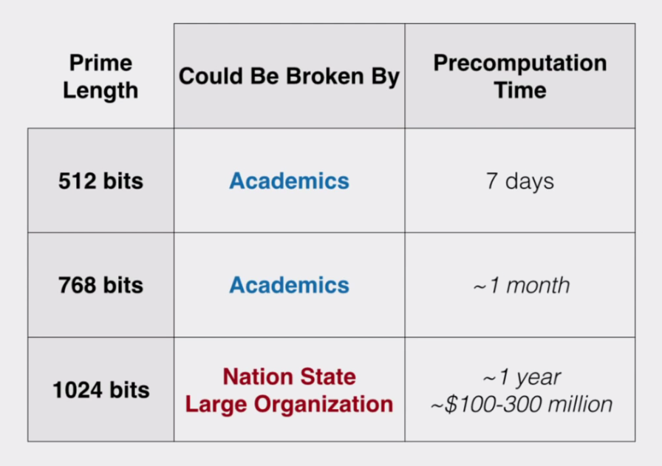
Logjam
Diffie-Hellman key exchange

Slide 26
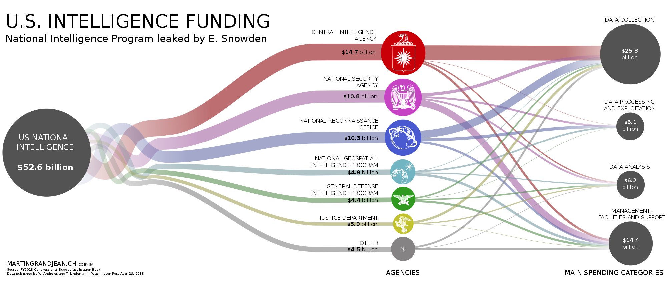
Logjam
Diffie-Hellman key exchange
Notes:
The NSA can use specialized hardware to speed up the process of breaking DH.

Slide 27
Applications
Used to provide PFS in TLS ephemeral modes.
SSH.
IPSec.
Diffie-Hellman key exchange

Slide 28
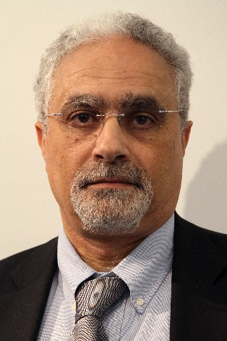
ElGamal public key cryptosystem
Proposed by Taher ElGamal in 1985.
Based on the discrete logarithm problem.
Closely related to the Diffie-Hellman key exchange.
Taher ElGamal
ElGamal public key cryptosystem
Notes:
The first public key cryptosystem was the RSA system.

Slide 29
ElGamal public key cryptosystem
The Diffie-Hellman key exchange algorithm does not achieve the full goal of being a public key cryptosystem.
A cryptosystem permits the exchange of specific information, not just a random string of bits.
With the use of an encoding scheme, a plaintext or ciphertext may be viewed as a sequence of bits (usually blocks of 8 bits).
ElGamal public key cryptosystem

Slide 30
Encoding schemes
Method of converting one sort of data into another sort of data (e.g. text into numbers).
Both the encoding and decoding functions are public knowledge and easy to compute.
Most commonly used encoding scheme is the ASCII code.
ElGamal public key cryptosystem

Slide 31
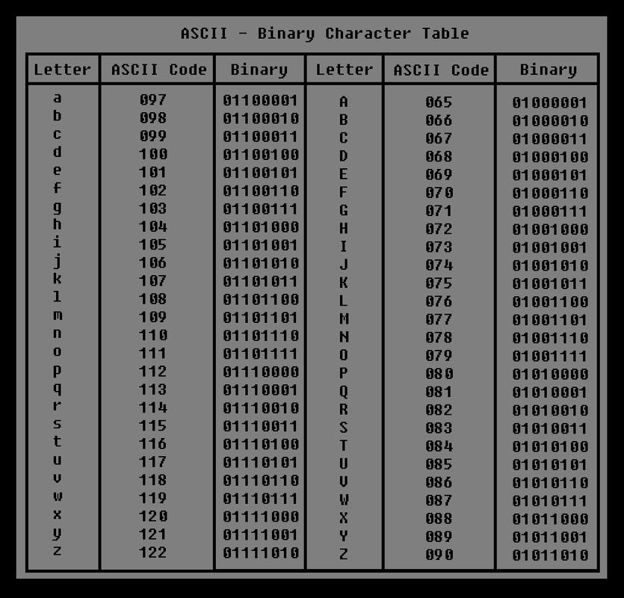
ASCII Table
ElGamal public key cryptosystem

Slide 32
Alice
Alice and Bob agree on a prime number p and a generator g such that: g is a primitive root of p p > g
Alice generates a random number (private key) a and computes: A ≡ gª (mod p) Alice then sends A to Bob
Alice receives (c₁, c₂)
Alice computes s = c₁ª (mod p) s⁻¹ = (c₁ª)⁻¹ ( mod p) m = c₂ * s⁻¹ (mod p)
Eve
Eve sees p and g
Eve sees A
Eve sees c₁ and c₂
Bob
Alice and Bob agree on a prime number p and a generator g such that: g is a primitive root of p p > g
Bob uses A, m and k and calculates: c₁ = g^{k} (mod p) c₂ = m * A^{k} (mod p)
Bob sends (c₁, c₂) to Alice
Step 1
Step 2
Step 3
Step 4
ElGamal public key cryptosystem
Notes:
She may chose p and g herself, or they may have been preselected by some party such as an industry panel or government agency.
The private key a is 1 ≤ a ≤ p – 1.
Bob’s message m is called plaintext, (c1, c2) is called ciphertext.
The number k is called an ephemeral key, since it exists only for the purposes of encrypting a single message.

Slide 33
Alice
p = 467 g = 2
a = 153 224 ≡ 2¹⁵³ (mod 467)
c₁ = 87 c₂ = 57
Alice computes s = 367 ≡ 87¹⁵³ (mod 467) s⁻¹ = 367x ≡ 1 (mod 467) = 14 m = 331 ≡ 57 * 14 (mod 467)
Eve
Eve sees 467 and 2
Eve sees 224
Eve sees c₁ = 87 and c₂ = 57
Bob
p = 467 g = 2
A = 224 m = 331 k = 197 c₁ = 87 ≡ 2¹⁹⁷ (mod 467) c₂ = 57 ≡ 331 * 224¹⁹⁷ (mod 467)
Bob sends c₁ and c₂ to Alice
Step 1
Step 2
Step 3
Step 4
ElGamal public key cryptosystem

Slide 34
Efficiency
In the ElGamal cryptosystem the plaintext message m is an integer between 2 and p – 1.
The ciphertext integers c₁ and c₂ are in the same range.
In general, it takes twice as many bits to write down the ciphertext compared to the plaintext.
ElGamal has a 2-to-1 message expansion.
ElGamal public key cryptosystem

Slide 35
Security
As the Diffie-Hellman key exchange algorithm, the ElGamal public key cryptosystem relies on the fact that the Diffie-Hellman Problem and more so the Discrete Logarithm Problem are hard to solve.
In conclusion, the ElGamal cryptosystem is at least as hard to attack as its underlying problem.
ElGamal public key cryptosystem

Slide 36
Chosen ciphertext attack
An attack in which Eve has access to an oracle that decrypts arbitrary ciphertexts.
The ElGamal cryptosystem is proven to be secure agaisnt chosen ciphertext attacks if one assumes that the Diffie-Hellman Problem is hard.
ElGamal public key cryptosystem

Slide 37
References
https://en.wikipedia.org/wiki/Diffie%E2%80%93Hellman_key_exchange
https://en.wikipedia.org/wiki/ElGamal_encryption
https://www.ietf.org/rfc/rfc3526.txt
https://www.keylength.com/en/compare/
https://weakdh.org/
https://en.wikipedia.org/wiki/Pohlig%E2%80%93Hellman_algorithm
https://en.wikipedia.org/wiki/General_number_field_sieve
An Introduction to Mathematical Cryptography (by Jeffrey Hoffstein, Jill Pipher, J.H. Silverman)

Slide 38

Questions?

